Slide 1
Ethics Training
For Division of Forestry
Maria Bahr
Ethics Counsel, Department of Law

Slide 2
General Overview
Background, 1986
The Act – many pages long, but here summary of what is most important to YOU.

Slide 3
Definitions
You have to know the who’s who and the what’s what to really understand the Act.

Slide 4

Public Officer
A public employee
A member of a board or commission
YOU

Slide 5
$$ Financial Interest $$
An interest held by you or an immediate family member which includes involvement or ownership in a business, including property, or a professional or private relationship that is the source of income or from which you have received or expect to receive income.
Also means holding a position in a business, such as officer, director, trustee, partner, employee, or a position of management.

Slide 6
Personal Interest
An interest held by you or your immediate family, including membership in any organization – fraternal, nonprofit, charitable, for profit, political – from which you derive a benefit.
“Membership” broad definition: not just voting member, even advisory, on the rolls.

Slide 7
Benefit
Anything that is to your advantage or self-interest, or from which you gain financially, including dividend, pension, salary, acquisition, agreement to purchase, transfer of money, deposit, loan, promise to pay, grant, contract, lease, money, goods, services, privileges, patronage, advantage, advancement, or anything else of value.
Very broad definition: If you like it, it’s a benefit.

Slide 8

Immediate Family Member
Spouse
Conjugal partner
Children, step-children
Parents, siblings, grandparents, aunts, uncles
Parents-in-law, brother and sister-in-law
That’s your family

Slide 9


Official Action
Giving advice, participating, assisting, making a recommendation, making a decision, approving, disapproving, voting, or other similar action by a public officer.

Slide 10
Partisan Political Activity
Those activities that are intended to benefit or harm a candidate, potential candidate, political party or group.
Exceptions – we’ll get to those in a minute: home, phones, plane.

Slide 11
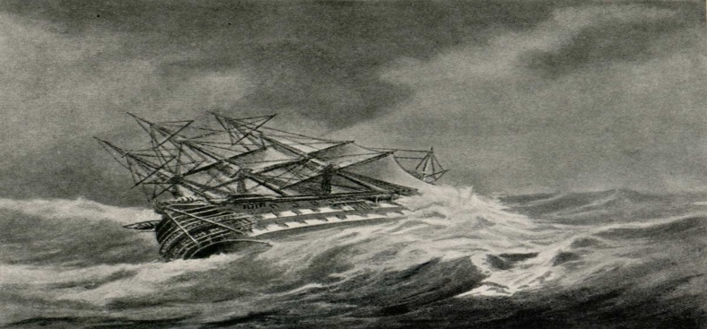
Designated Ethics Supervisor
The person you go to for assistance and guidance in navigating the provisions and requirements of the Ethics Act.
Depends on the Agency or Board. (Chair for board members and ED; Governor for chair.)

Slide 12

Let’s jump in…

Slide 13
Basic Premise
Avoid substantial and material conflicts of interest.
You and your immediate family members may not benefit financially or personally from your position and actions as a state officer.
You may not confer unwarranted benefits on others.

Slide 14

Scope
Prohibits substantial and material conflicts of interest.
States that a public officer (and immediate family) may not improperly benefit financially or personally from their position and actions as state officers.

Slide 15

However…
The Act does recognize that independent pursuits should not be discouraged
Many of you are here precisely because of your independent pursuits and interests,
And some minor and
inconsequential conflicts
of interest are unavoidable.
Such as….

Slide 16

Stocks and bonds
If your ownership interest or value in a company is less than $5,000, it is presumed to be insignificant.

Slide 17

Held by larger class of persons
Your personal or financial interest in a matter is also presumed to be insignificant if it is held generally by the public at large, or by a larger class of persons.
Example: PFD

Slide 18
Insignificant or Conjectural
If your action or influence would have insignificant or merely conjectural effect on a matter, the conduct is not prohibited.
Mere appearance of impropriety not enough, needs to be an actual conflict.
Example: using state phone or computer to check on babysitter or make a personal call. (But not managing your rental unit.)

Slide 19
Misuse of Official Position
The Grand-daddy of them all.
AS 39.52.120

Slide 20

Misuse of Official Position
Can’t
Can’t
Nope
Sorry
Cannot
No way
No sir
No-can-do
Can’t

Slide 21
Misuse of Official Position
Can’t use position for personal gain, or to give unwarranted benefit or treatment to another person; (hiring a friend who is unqualified);
Can’t use your position to secure other employment or contracts; (I’ll do this for you if you give me a job when I leave);
Can’t use your position to accept or solicit outside compensation; (no tips for doing your job).

Slide 22
Misuse of Official Position
Can’t use state resources to benefit a personal or financial interest, and
Can’t take or withhold official action on matters in which you have a personal or financial interest, unless…
It’s an insignificant interest (less than $5,000 in a business), or interest possessed generally by public at large, or action would have insignificant or conjectural effect on the matter.

Slide 23

Misuse of Official Position
Can’t coerce subordinates to do something for your own personal or financial benefit (for instance, giving to a charity or political party of your choice… or moving your furniture, or making them terminate someone because you don’t like them).

Slide 24

Misuse of Official Position
Can’t attempt to influence the outcome of an administrative hearing by privately contacting the hearing officer (but, you can respond to hearing officer’s request for additional information).

Slide 25
Politics
Cannot use state funds, equipment, or facilities for partisan political purposes.
Remember, these are activities that are intended to benefit or harm a candidate, potential candidate, political party or group.
For example, cannot use state computer or state time to send campaign letters in support of candidate or cause.

Slide 26

Exceptions: Governor’s Mansion

Slide 27
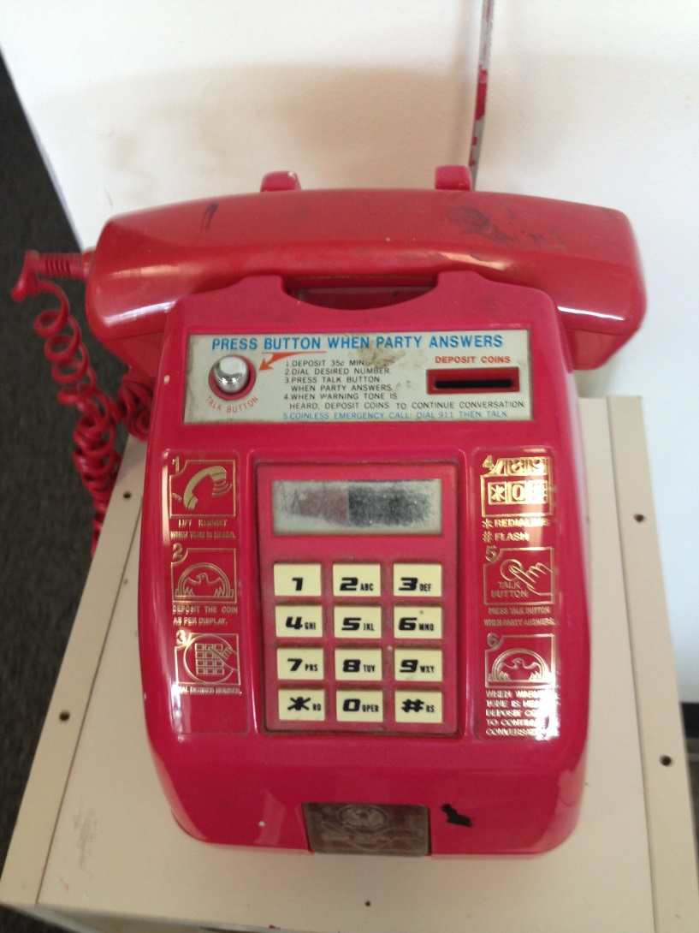
Exceptions: Communications Equipment in Governor’s Home

Slide 28

Exceptions: Airplane

Slide 29

Cannot use state equipment for political purposes
No after-hours emails or epic copying jobs using state resources.

Slide 30
The State Cannot Restrict…
The State cannot restrict or attempt to restrict after working-hours statements, pronouncements or other activities, not otherwise prohibited by law or personnel rule, of any employee of the state, if the employee does not purport to speak or act in an official capacity. AS 39.26.010

Slide 31
Special Considerations for Board Members
Declaration of Potential Violations by Members of Boards or Commissions
AS 39.52.220
Improper Representation
AS 39.52.160

Slide 32
Declaration of Potential Conflicts
Special Provision for Members of Boards and Commissions
A member of a board or commission who is involved in a matter that may result in a violation of any of the other provisions of the Ethics Act, must disclose the matter on the public record, in writing (the in writing requirement may be met by disclosing on the record at a public meeting if a written record or electronic recording is kept of the meetings).

Slide 33
Declaration of Potential Conflicts, cont.
The DES (the Chair) shall determine whether the member’s involvement in the matter violates any of the provisions of the Ethics Act and will provide a written determination (or a determination on the record if the meeting is being recorded).
If a member objects to the ruling/determination of the DES, the members present (minus the one with the potential conflict) will vote on the matter.
If the DES or a majority of the members determine there is a conflict, then the member will refrain from voting, deliberating, or participating in the matter.

Slide 34
Improper Representation
(AS 39.52.160)
General Rule: You cannot advise or assist a person in matters pending before your administrative unit for compensation, or if your assistance would in any way benefit your personal or financial interests.
But, non-salaried members of boards or commissions are allowed to represent, advise, or assist in any matter in which the member has a personal or financial interest regulated by the board, but must do so in accordance with AS 39.52.220.

Slide 35
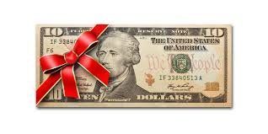
Gifts
Can’t accept or solicit a gift if that gift is intended to influence your action or judgment in your official duties.
Gifts are money, services, loans, travel, entertainment, hospitality, lunch, a place to stay, tickets to an event….

Slide 36
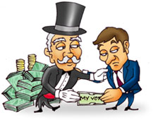
Gifts
All gifts from lobbyists are presumed to be improper (unless they are an immediate family member, or long-time family friend…but even that is risky.)

Slide 37
Gifts
A gift worth more than $150 to you or your immediate family must be reported if:
You could take official action that would affect the gift-giver, or
The gift is being given to you because of your position as a public employee.

Slide 38
Gifts
A gift of an amount less than $150 should still be disclosed if one could “reasonably infer from the circumstances” that the gift was intended to influence your action or judgment.
When in doubt, DISCLOSE!

Slide 39

Gifts
Any gift received from another government, regardless of value, must be disclosed. This includes foreign, federal, state, municipal, and tribal governments.

Slide 40

Gifts, Ethics Act, Family
You must report a gift that a family member receives if it would be reportable if you received it.

Slide 41

Questions
Can I keep this gift basket?
Can I keep this bottle of wine?
Can I keep this gift card?
$50 presumption
9 AAC 52.060 (a)

Slide 42

Information
AS 39.52.140
A current or former public officer may not disclose or use information gained in the course of official duties that could in any way result in a benefit to the officer or their immediate family member, if the information has not been publicly disseminated, or is confidential by law.

Slide 43

No insider trading
Present and future

Slide 44

Non-public and Confidential Information
It is only publicly disseminated if follows
9 AAC 52.070:
Newspaper, broadcast, press release, newsletter, legal notice, non-confidential court filing, published report, agency’s website, Alaska Online Public Notice System, public speech, public testimony.
NOT just if discoverable under FOIA request.

Slide 45
Improper Influence in State Grants, Contracts, Leases, or Loans
A public officer or immediate family member cannot attempt to acquire, receive, apply for, or have a personal or financial interest in a state grant, contract, lease or loan, if the public officer may take action that affect the award. AS 39.52.150(a)

Slide 46

Improper Influence in State Grants, Contracts, Leases, or Loans

Slide 47
Improper Influence in State Grants, Contracts, Leases or Loans
A public officer shall report in writing to the designated ethics supervisor a personal or financial interest held by the officer, or an immediate family member, in a state grant, contract, lease, or loan that is awarded by the agency the officer serves. AS 39.52.150(d)

Slide 48

Post-State Employment
AS 39.52.180

Slide 49
Ethics Act, 39.52.180
A Public Officer, after leaving state service
Two year restriction on
A matter
For compensation
In which you participated personally and substantially
Through the exercise of official action
(each phrase subject to interpretation and analysis; all must be met)

Slide 50
What’s the matter?
“Matter” includes case, proceeding, application, contract, determination, proposal or consideration of a legislative bill, a resolution, a constitutional amendment, or other legislative measure, or proposal, consideration, or adoption of an administrative regulation. AS 39.52.180(a)
“Matter” does not include the general formulation of policy. 9 AAC 52.100
Construed narrowly (not a continuation or Part 2).

Slide 51
Don’t take it personally
For purposes of AS 39.52.180(a), routine processing of documents, general supervision of employees without direct involvement in a matter, or ministerial functions not involving the merits of a matter under consideration by an administrative unit do not constitute personal or substantial participation in a matter by a public officer. 9 AAC 52.100

Slide 52

Personal and Substantial
30,000 foot view

Slide 53

Personal and Substantial
10,000 foot view

Slide 54
Personal and Substantial
Being a supervisor and being aware of the work of others does not necessarily constitute “personal and substantial” involvement for purposes of post-state employment restrictions.

Slide 55
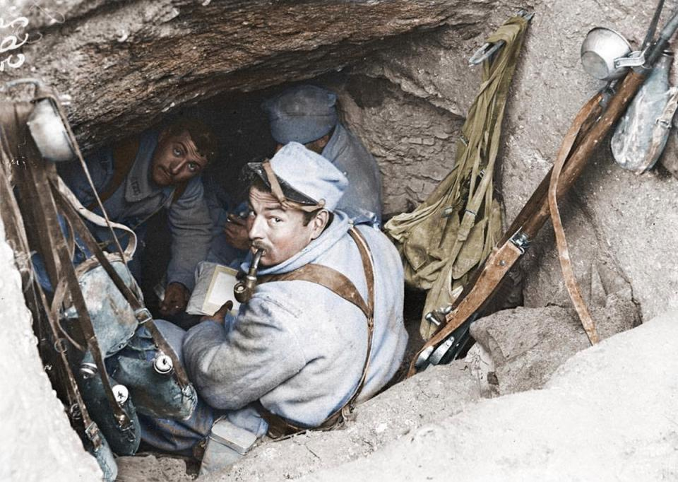
Personal and Substantial
In the trenches

Slide 56

Make it official
“Official action” means advice, participation, or assistance, including, for example, a recommendation, decision, approval, disapproval, vote, or other similar action, including inaction, by a public officer.
AS 39. 52.960(14)

Slide 57
Post-State Employment Exceptions
Can contract with former agency.
Can get public interest waiver (approved by your agency and the Attorney General).
AS 39.52,180(b)(c)

Slide 58
Restrictions on Employment After Leaving State Service
The Ethics Act’s restriction on employment after leaving state service prohibits certain former officials from working as paid lobbyists for one year after leaving state service.

Slide 59
Restrictions on Employment After Leaving State Service
The one-year lobbying restriction applies to the following positions:
  Governor and Lt. Governor;
  head of an executive branch department;
  deputy head of an executive branch department;
  director of a division within an executive branch department;
  legislative liaison within an executive branch department;
  legislative liaison, administrative assistant, or other policy-making position in the Office of the Governor or Office of the Lt. Governor;
  member of a board or commission having regulation-adoption authority; and
  member of the governing board and executive officer of a state public corporation.

Slide 60
Ethics Act, 39.52.140
Penalties?
Up to $5,000/violation, pay back up to 2X the financial benefit received via the infraction, any other civil penalties, any actions related to the infraction (such as a contract or lease) are voidable.

Slide 61

What happens?

Slide 62
Who to call
Maria Bahr, 269-5285.
Your Designated Ethics Supervisor

